Slide 1
ELEMENTARY STATISTICS, BLUMAN
TI Graphing Calculator - Quartiles
© 2019 McGraw-Hill Education. All rights reserved. Authorized only for instructor use in the classroom. No reproduction or further distribution permitted without the prior written consent of McGraw-Hill Education.

Slide 2
Objectives for this PowerPoint
Use the TI graphing calculator to find the quartiles for a data set
Find the interquartile range for a data set.

Slide 3
Data Set 1
21 | 53
21 | 53
24 | 54
24 | 57
32 | 58
34 | 59
35 | 60
36 | 61
38 | 64
42 | 64
44 | 65
45 | 84
46 | 89
47 | 92
51 | 98
Thirty students in a class took a test. The scores are shown to the right. The instructor wished to find the quartiles for this set of data.

Slide 4
Quartiles
The quartiles separate a data set into 4 equal groups.
We can use the TI graphing calculator to find the quartiles.

Slide 5
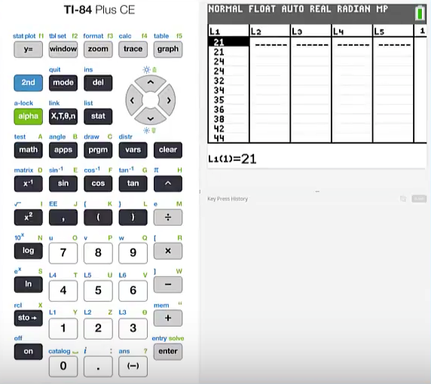
TI – Find Quartiles Data Set 1 (1)
We will begin by entering the data into a list.
We will enter this data into List 1.
Press stat and 1 to enter data

Slide 6
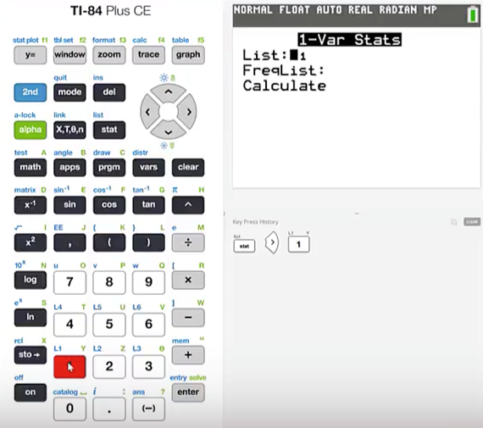
TI – Find Quartiles Data Set 1 (2)
In order to find the quartiles
Press stat
Cursor over to CALC
Press 1 for 1 Variable Statistics
Specify List 1 since that is where we have placed our data
Cursor down to Calculate and press enter.

Slide 7
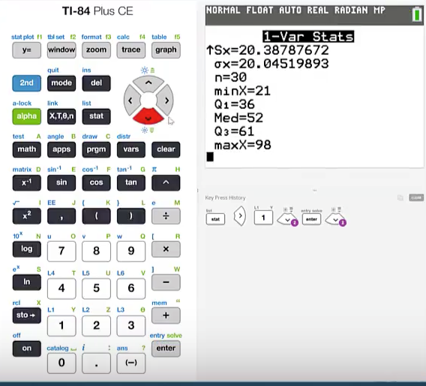
TI – Find Quartiles Data Set 1 (3)
Cursor down to the bottom and we will find the 1st quartile is 36.
The median or the 2nd quartile is 52 and the 3rd quartile is 61.

Slide 8
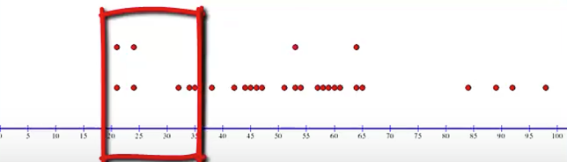
Dot Plot – Data Set 1 (1)
Here is a dot plot for the data.
The bottom 25% of the data extends from the minimum value of 21 up to the 1st quartile of 36.

Slide 9
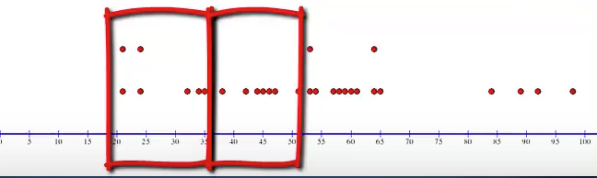
Dot Plot – Data Set 1 (2)
The next 25% of the data set extends from the 1st quartile of 36 up to the 2nd quartile or median of 52.

Slide 10
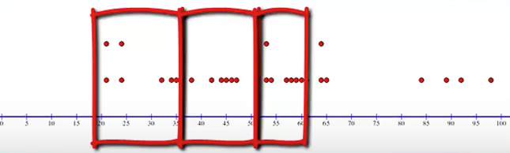
Dot Plot – Data Set 1 (3)
The next 25% of the data extends from the 2nd quartile of 52 up to the 3rd quartile of 61.

Slide 11
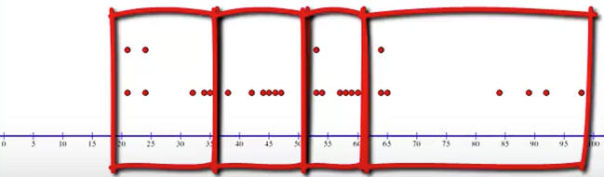
Dot Plot – Data Set 1 (4)
The upper 25% extends from the 3rd quartile of 61 up to the maximum value of 98.

Slide 12
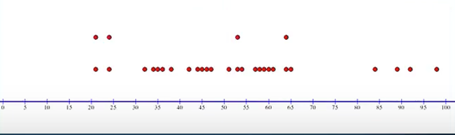
Dot Plot – Data Set 1 (5)
Although these intervals vary in width, it is important to note that each contains the same number of data values.
These varying widths exhibit the way that data values are distributed between these intervals, in addition to dividing the data set into 4 equal groups.

Slide 13

IQR (1)
Quartiles can be used as a rough measure of variability. This measure of variability which uses quartiles is called the interquartile range and is the range of the middle 50% of the data values.
The interquartile range is abbreviated IQR. The formula for the interquartile range is simply to subtract the 1st quartile from the 3rd quartile.
$$IQR=Q_{3}−Q_{1}$$

Slide 14

IQR (2)
For the test score data the IQR is the following:
Q₁ = 36
Q₂ = Median = 52
Q₃ = 61
$$IQR=Q_{3}−Q_{1}=61 −36=25$$

Slide 15
Data Set 2
38 | 83
42 | 84
46 | 84
52 | 85
58 | 85
65 | 89
68 | 90
72 | 90
75 | 92
76 | 93
77 | 93
78 | 94
81 | 96
82 | 97
83 | 98
This means that the middle 50% of the data has a span of 25 units. The instructor decided to allow the students to retake the test. The scores for the retake are shown to the right.

Slide 16
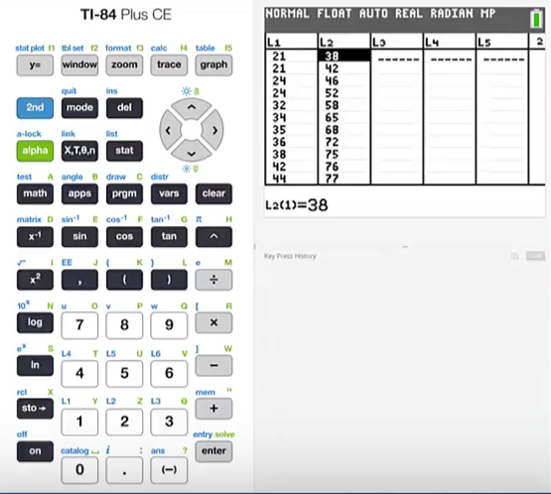
TI – Find Quartiles Data Set 2 (1)
The instructor wishes to find the quartiles for the scores for the retaken test.
We will enter this data set into List 2.

Slide 17
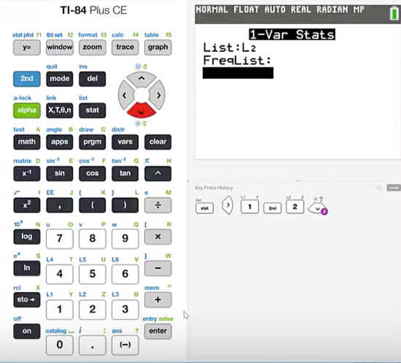
TI – Find Quartiles Data Set 2 (2)
Press stat
cursor over to CALC
press 1 for 1 Variable Statistics
We want to find the quartiles for the data values that are in List 2.
Press 2nd L2 to change the specified list to List 2.
Cursor down to Calculate and press enter.

Slide 18
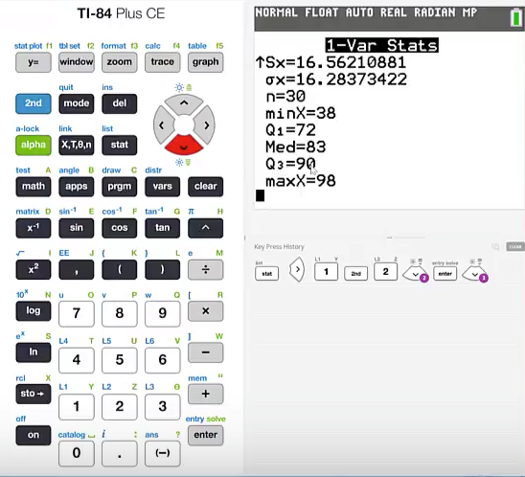
TI – Find Quartiles Data Set 2 (3)
Cursor down to the bottom and find that the 1st quartile is 72.
The median or 2nd quartile is 83 and the 3rd quartile is 90.

Slide 19
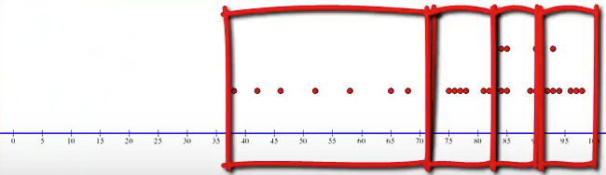
Dot Plot – Data Set 2 (1)
A dot plot shows us the span of data points in each quartile. The interquartile range for this data set is 18.
Q₁ = 72
Q₂ = Median = 83
Q₃ = 90
IQR = 90 – 72 = 18

Slide 20
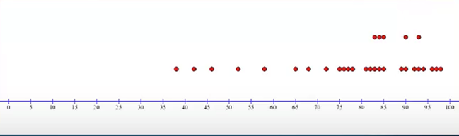
Dot Plot – Data Set 2 (2)
The middle 50% of the data values are concentrated into a shorter span for the second set of data.

Slide 21
Summary
In this PowerPoint we learned how to use the TI graphing calculator to find the quartiles for a data set.
We also learned how to find the interquartile range for a data set.

